Slide 1
Computer Networks EDA387/DIT661
Socket API
Based on Ch. 1 to 6 in Stevens’s UNIX Network Programming

Slide 2
Outline
Outline
Part I
Introduction
The Client Server (review)
The Socket Interface
Lab 1 - Host Resolution
Summary

Slide 3
Networking API
Objectives
This part review the programming of processes that communicate with each other using an application program interface (API) known as sockets.
Some students may be very familiar with sockets already, as that model has become synonymous with network programming.
Others may need an introduction to sockets from the ground up.

Slide 4
Networking API
Objectives
The objective of this lecture is to offer guidance on network programming for beginners as well as advanced programmers, for those developing new network-aware applications as well as those maintaining existing code.
By the end of this part, your understanding of this area shall include the ability to discuss in detail how the networking components of their system function as well as how to program them.

Slide 5
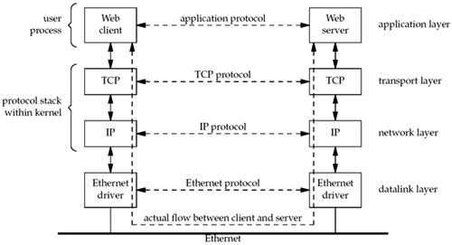
Client and Server Ethernet communication using TCP
Review
Notes:
http://www.youtube.com/watch?v=gZlNNiI-hq0

Slide 6
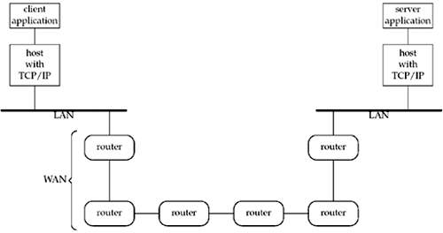
Client and Server Ethernet communication using TCP
Review

Slide 7
Internet Connections (TCP/IP)
Preview
Two paradigms for communication between clients and servers
Datagrams (UDP protocol SOCK_DGRAM)
Connections (TCP protocol, SOCK_STREAM)
Connections are point-to-point, full-duplex (2-way communication), and reliable and our main focus
Client socket address
128.2.194.242:3479
Server socket address
208.216.181.15:80
Client
Server
(port 80)
Connection socket pair
(128.2.194.242:3479, 208.216.181.15:80)
Client host address
128.2.194.242
Server host address
208.216.181.15
Note: 3479 is an
ephemeral port allocated
by the kernel
Note: 80 is a well-known port
associated with Web servers

Slide 8
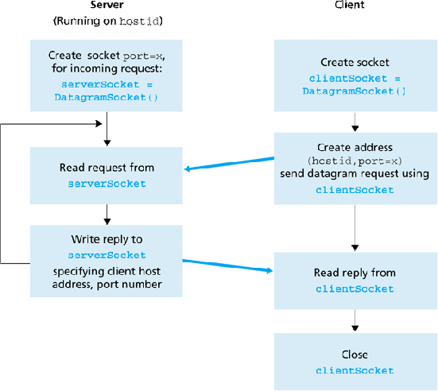

Java View of Internet API
Review

Slide 9
Overview of BSD Sockets Interface
Client
Server
Preview
socket
socket
bind
open_listenfd
open_clientfd
listen
Connection
request
connect
accept
Client / Server
Session
write
read
Await connection
request from
next client
read
write
close
EOF
read
close

Slide 10
Summary of Part I
We have reviewed client-server programing in C
Now you are ready for the 1st programming lab

Slide 11
Outline
Outline
Part II
The Daytime server example
Accept, Connection, Send and Reply
TCP State Transition
Port Numbers
Summary

Slide 12
A Simple Daytime Client
int main(int argc, char **argv) {
int sockfd, n; char recvline[MAXLINE + 1];
struct sockaddr_in servaddr;
if (argc != 2) err_quit("usage: a.out <IPaddress>");
if ( (sockfd = socket(AF_INET, SOCK_STREAM, 0)) < 0) err_sys("socket error");
bzero(&servaddr, sizeof(servaddr));
servaddr.sin_family = AF_INET;
servaddr.sin_port = htons(13); /* daytime server */
if (inet_pton(AF_INET, argv[1], &servaddr.sin_addr) <= 0)
err_quit("inet_pton error for %s", argv[1]);

Slide 13
A Simple Daytime Client
if (connect(sockfd, (SA *) &servaddr,sizeof(servaddr))< 0) err_sys("connect error");
while ( (n = read(sockfd, recvline, MAXLINE)) > 0) {
recvline[n] = 0; /* null terminate */
if (fputs(recvline, stdout) == EOF)
err_sys("fputs error");
}
if (n < 0) err_sys("read error");
exit(0);
}

Slide 14
Daytime Client: TCP socket
Self-study
sockfd = socket(AF_INET, SOCK_STREAM, 0) creates TCP socket
Returns a small integer descriptor used for identification
The call to socket can fail, why?
We will encounter many different uses of the term "socket"
The API that we are using is called the sockets API
The function named socket that is part of the socket API
The TCP socket, which is a TCP endpoint

Slide 15
Reading the Server's Reply
Self-study
Must be careful when using TCP because it is a byte-stream protocol with no record boundaries
Mon May 26 20 : 58 : 40 2003\r\n
(\r carriage return and \n linefeed)
Can be returned in numerous ways:
Normally, 1 TCP segment of all 26 bytes,
can also be 26 TCP segments each containing 1 byte of data, etc
Always need to code the read in a loop and terminate the loop when either read returns 0 (i.e., the other end closed the connection) or a value less than 0 (an error)
This technique is also used by version HTTP 1.0

Slide 16
A Simple Daytime Server
int main(int argc, char **argv) {
int listenfd, connfd;
struct sockaddr_in servaddr;
char buff[MAXLINE]; time_t ticks;
listenfd = Socket(AF_INET, SOCK_STREAM, 0);
bzeros(&servaddr, sizeof(servaddr));
servaddr.sin_family = AF_INET;
servaddr.sin_addr.s_addr = htonl(INADDR_ANY);
servaddr.sin_port = htons(13); /* daytime server */

Slide 17
A Simple Daytime Server
Bind(listenfd, (SA *) &servaddr, sizeof(servaddr));
Listen(listenfd, LISTENQ);
for ( ; ; ) {
connfd = Accept(listenfd, (SA *) NULL, NULL);
ticks = time(NULL);
snprintf(buff, sizeof(buff), "%.24s\r\n", ctime(&ticks));
Write(connfd, buff, strlen(buff));
Close(connfd);
}}

Slide 18
Outline
Outline
Part II
The Daytime server example
Accept, Connection, Send and Reply
TCP State Transition
Port Numbers
Summary

Slide 19
Accept Connection & Send Reply
The server process is put to sleep in the call to accept, waiting for connections to arrive and be accepted
TCP connections use a three-way handshake to establish a connection
When this handshake completes, accept returns, and the return value from the function is a new descriptor (connfd) that is called the connected descriptor
This new descriptor is used for communication with the new client

Slide 20
Accept Connection & Send Reply
The server handles only one client at a time
If multiple client connections arrive at about the same time, the kernel queues them, up to some limit, and returns them to accept one at a time
The daytime server is quite fast
But if the server took more time to service each client, we would need some way to overlap the service of one client with another client
This design is called the iterative server

Slide 21
Iterative Servers
Iterative servers process one request at a time.
client 1
server
client 2
call connect
call accept
call connect
ret connect
call read
ret accept
write
ret read
close
close
call accept
ret accept
ret connect
write
call read
ret read
close
close

Slide 22
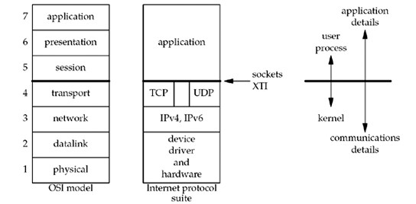
OSI Model
Review

Slide 23
TCP: Establishment & Termination
Review
To understanding of the connect, accept, and close functions, we must understand how:
TCP connections are established and terminated
TCP's state transition diagram.

Slide 24
Three-way Handshake
Review
Server prepare to accept an incoming connection
Normally done by calling socket, bind, and listen and is called a passive open
The client issues an active open by calling connect
TCP client sends a "synchronize" (SYN) segment
tells the server about the client's initial sequence number for the data that the client will send on the connection
No data sent with the SYN; just IP header, a TCP header, and possible TCP options

Slide 25
Three-way Handshake
Review
Server must acknowledge (ACK) the client's SYN and the server must also send its own SYN containing the initial sequence number for the data that the server will send on the connection
The server sends its SYN and the ACK of the client's SYN in a single segment
The client must acknowledge the server's SYN

Slide 26
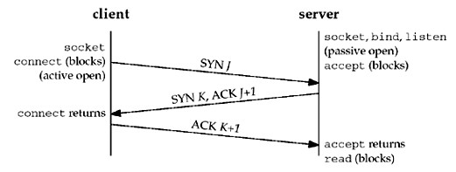
Three-way Handshake
Review

Slide 27
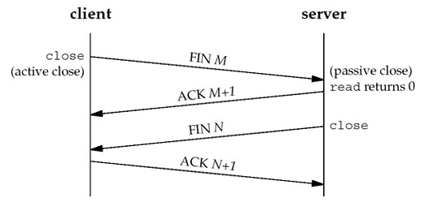
TCP Connection Termination
Review

Slide 28
Outline
Outline
Part II
The Daytime server example
Accept, Connection, Send and Reply
TCP State Transition
Port Numbers
Summary

Slide 29
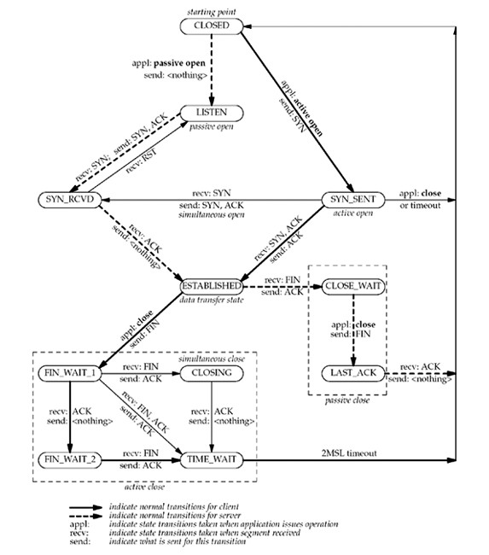
TCP State Transition
If an application performs an active open in the CLOSED state, TCP sends a SYN and the new state is SYN_SENT
If TCP next receives a SYN with an ACK, it sends an ACK and the new state is ESTABLISHED
Notes:
Stopped here!

Slide 30
TCP State Transition Diagram
The two arrows leading from the ESTABLISHED state deal with the termination of a connection
If an application calls close before receiving a FIN (an active close), the transition is to the FIN_WAIT_1 state
If an application receives a FIN while in the ESTABLISHED state (a passive close), the transition is to the CLOSE_WAIT state
Simultaneous open: both ends send SYNs at about the same time and the SYNs cross in the network
Simultaneous close: both ends send FINs at the same time

Slide 31
TIME_WAIT State
An active-close-end goes through this state
remains in this state is 2X the maximum segment lifetime
Maximum Segment Lifetime (MSL) = max time that any IP datagram can live in a network
It is bounded: every datagram contains an 8-bit hop limit
recommended value (RFC1122) is 2 min, BSD uses 30 sec.
means TIME_WAIT duration is between 1 and 4 min.
Packet lost is usually the result of routing problems
Once routing problem is corrected and the packet that was lost in the loop is sent to the final destination
Happens within MSL time

Slide 32
TIME_WAIT State
Implement TCP's full-duplex connection termination
Allow old TCP duplicate to expire in the network

Slide 33
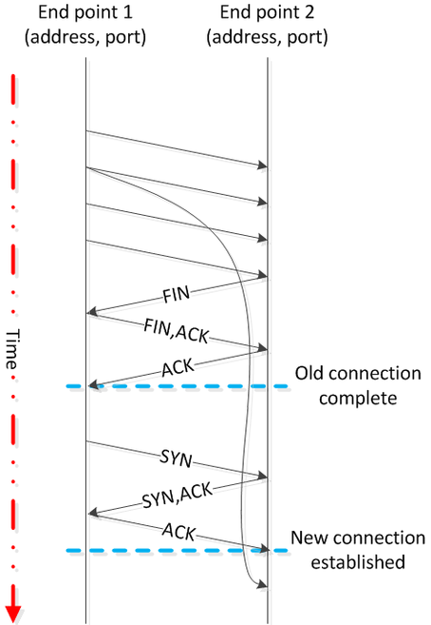
TIME_WAIT
Suppose that end point 2 wasn't in TIME_WAIT state when a delayed segment arrives.
That segment is mistaken for part of the second connection (when it has an appropriate sequence numbers) .

Slide 34
TIME_WAIT
When the final ACK (end point 2) omitted, end point 1 will resend the final FIN.
If end point 2 state is CLOSED, it sends RST (unexpected FIN).
End point 1 receive an error even though all data was received correctly.

Slide 35
Expiring TCP duplicates
Initiate a new incarnation of a connection that is currently in the TIME_WAIT state
Since the duration of the TIME_WAIT state is twice the MSL, this allows MSL sec. for a packet in one direction to be lost, and another MSL sec. for the reply to be lost
Guaranteed that when establishing a connection, all old duplicates from previous incarnations of the connection have expired in the network

Slide 36
Outline
Outline
Part II
The Daytime server example
Accept, Connection, Send and Reply
TCP State Transition
Port Numbers
Summary

Slide 37
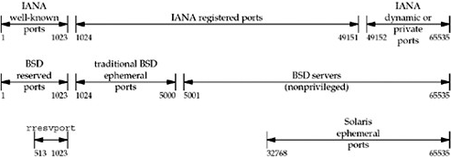
Port Numbers
Review
Well-known: Internet Assigned Numbers Authority
Registered: IANA only lists the uses of these ports
Dynamic or Private: not control (ephemeral ports)
Notes:
Stoped here

Slide 38
Ephemeral Ports
Review
Ephemeral (short-lived) ports are used for the client end to a well-known port on a server
Ephemeral ports may also be used to free up a well-known service listening port and establish a service connection to the client host
The allocations are temporary and only valid for the duration of the communication session
After completion of the communication session, the ports become available for reuse

Slide 39
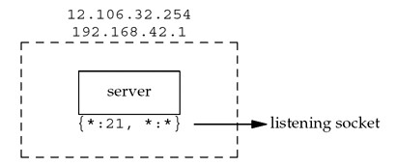
TCP Port Numbers and Concurrent Servers
Let's consider a multihomed host with 2 IP addresses 12.106.32.254 and 192.168.42.1, and the server does a passive open using its well-known port, e.g., 21
{*:21, *:*} indicates the server's socket pair
Server waits for connection requests on local interfaces (1st *) and port 21

Slide 40
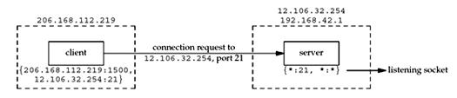
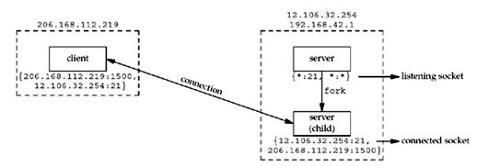
TCP Port Numbers and Concurrent Servers
When the server receives and accepts the client's connection, it forks a copy of itself, letting the child handle the client

Slide 41
TCP Port Numbers and Concurrent Servers
Server host must distinguish between the listening socket and the connected socket
Connected socket uses the same local port (21) as the listening socket
The multihomed server, the local address is filled in for the connected socket (12.106.32.254) once the connection is established
Assume that another client process on the client host requests a connection with the same server

Slide 42
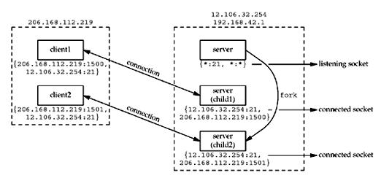
TCP Port Numbers and Concurrent Servers
TCP code on the client host assigns the new client socket an unused ephemeral port number, e.g.,1501
On the server, the two connections are distinct

Slide 43
TCP Port Numbers and Concurrent Servers
TCP cannot demultiplex incoming segments by looking at just the destination port number
TCP must look at all four elements in the socket pair to determine which endpoint receives an arriving segment

Slide 44
Outline
Outline
Part II
The Daytime server example
Accept, Connection, Send and Reply
TCP State Transition
Port Numbers
Summary

Slide 45
Summary of Part II
We have seen our first client-server program
We reviewed the TCP protocol, its state machine and the use of the socket pair

Slide 46
Outline
Outline
Part III
Elementary TCP Sockets
Summary

Slide 47
Elementary TCP Sockets
We are now ready to describe the elementary socket API in more details by revising our TCP client and server programs
We first consider each of the system calls and enhance our examples

Slide 48
Overview of BSD Sockets Interface
Client
Server
socket
socket
bind
open_listenfd
open_clientfd
listen
Connection
request
connect
accept
Client / Server
Session
write
read
Await connection
request from
next client
read
write
close
EOF
read
close

Slide 49
TCP State Transition
CLOSED is the state in which a socket begins when it is created by the socket function

Slide 50
connect Function
TCP client establishes a connection with its server
int connect(int sockfd, const struct sockaddr *servaddr, socklen_t addrlen);
Client does not have to call bind before calling connect:
kernel will choose both an ephemeral port and the source IP address if necessary
For TCP sockets, connect initiates TCP's three-way handshake and returns only when the connection is established, or an error occurs

Slide 51
connect Function
Self-study
If the client TCP receives no response to its SYN segment, a timeout error is returned
4.4BSD, for example, sends one SYN when connect is called, another 6 seconds later, and another 24 seconds later
An error is returned when no response is received within 75 sec
If the server's response to the client's SYN is a reset (RST), this indicates that no process is waiting for connections on the server host at the port specified
the server process is probably not running
connection refused is returned to the client upon the RST arrival

Slide 52
connect Function
Self-study
An RST is a type of TCP segment that is sent by TCP when something is wrong
a SYN arrives for a port that has no listening server
TCP wants to abort an existing connection
TCP receives a segment for a connection that does not exist

Slide 53
connect Function
Self-study
Suppose that the client's SYN elicits an ICMP "destination unreachable" from some intermediate router,
Soft error: Kernel saves the message but keeps sending SYNs
If no response is received after some fixed amount of time (75 sec), the saved ICMP error causes the error returned value
host or network unreachable
ICMP error can indicate a transient condition
it could be that the condition is caused by a routing problem that will be corrected

Slide 54
TCP State Transition
moves from CLOSED to SYN_SENT, and on success, to STABLISHED
On failure, the socket is no longer usable (must close)
Cannot call connect again on the socket

Slide 55
bind Function
assigns a local protocol address to a socket
32-bit IPv4/128-bit IPv6 address and 16-bit TCP/UDP port
int bind (int sockfd, const struct sockaddr *myaddr, socklen_t addrlen);
Servers bind their well-known port when they start
kernel chooses ephemeral (short time) ports for the socket after calling connect or listen for unbounded sockets (client or server)
normal TCP clients rare for TCP servers

Slide 56
bind Function
Self-study
A process can bind a specific IP address to its socket
IP address must belong to an interface on the host
TCP client: assigns the source IP address that will be used for IP datagrams sent on the socket
clients do not do so normally, and the kernel chooses the source IP address based on the used outgoing interface
TCP server: restricts the socket to receive incoming client connections destined only to that IP address
If a TCP server does not bind an IP address to its socket, the kernel uses the destination IP address of the client's SYN as the server's source IP address

Slide 57
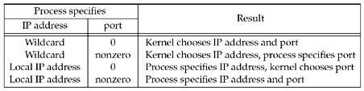
bind Function
Self-study
Result when specifying IP address and/or port number to bind
kernel chooses an ephemeral port when bind is called
when specifying a wildcard IP address, the kernel does not choose the local IP address until the socket is connected

Slide 58
listen Function
Called only by a TCP server
Converts an unconnected socket, which is assume to be an active socket, into a passive socket
kernel should accept incoming connection requests directed to this socket
moves the socket from the CLOSED state to the LISTEN state
specifies the maximum number of connections the kernel should queue for this socket
int listen (int sockfd, int backlog);
must be called before accept
normally called after both socket and bind

Slide 59
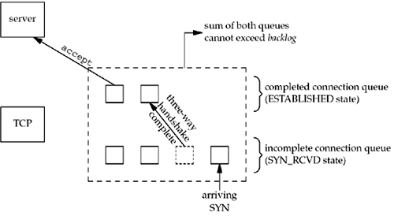
listen Function
Kernel maintains two queues:
Incomplete connection queue (SYN_RCVD): contains an entry for each SYN that has arrived from a client for which the server is awaiting completion of the TCP 3-way handshake
Completed connection queue (ESTABLISHED): contains an entry for each client with whom the handshake has completed

Slide 60
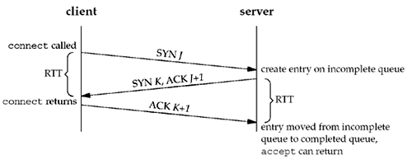
listen Function
Once an entry is created on the incomplete queue, the listen socket’s parameters are automatically copied over to the newly created connection
server process is not involved

Slide 61
accept Function
returns to the server the next completed connection from the front of the completed connection queue
If that queue is empty, the process is put to sleep (by default)
int accept (int sockfd, struct sockaddr *cliaddr, socklen_t *addrlen);
cliaddr and addrlen arguments are used to return the protocol address of the connected peer process
addrlen is a value-result argument: Before the call, *addrlen is the size of the structure pointed to by cliaddr; on return, contains the actual number of bytes stored by the kernel in the socket address structure

Slide 62
Connected vs. Listening Descriptors
Listening descriptor
End point for client connection requests.
Created once and exists for lifetime of the server.
Connected descriptor
End point of the connection between client and server.
A new descriptor is created each time the server accepts a connection request from a client.
Exists only as long as it takes to service client.
Why the distinction?
Allows for concurrent servers that can communicate over many client connections simultaneously.
E.g., Each time we receive a new request, we fork a child to handle the request.

Slide 63
close Function
closes a socket and terminates the TCP connection
int close (int sockfd);
mark the socket as closed and immediately returns
cannot be used to read or write
TCP will try to send any data that is already queued to be sent to the other end, and after this occurs, the normal TCP connection termination sequence takes place
SO_LINGER option lets us change this default action

Slide 64

Simple echo Client and Server

Slide 65
Example: Echo Client and Server
On Server
hive> echoserver 5000
server established connection with HIVE (128.252.21.14)
server received 4 bytes: 123
server established connection with HIVE (128.252.21.14)
server received 7 bytes: 456789
...
On Client
hive> echoclient hive 5000
Please enter msg: 123
Echo from server: 123
hive> echoclient hive 5000
Please enter msg: 456789
Echo from server: 456789
hive>

Slide 66
Echo Server
int main(int argc, char **argv) {
int listenfd, connfd; struct sockaddr_in servaddr; char buff[MAXLINE];
listenfd = Socket(AF_INET, SOCK_STREAM, 0);
bzeros(&servaddr, sizeof(servaddr)); servaddr.sin_family = AF_INET;
servaddr.sin_addr.s_addr = htonl(INADDR_ANY); servaddr.sin_port = htons(7);
Bind(listenfd, (SA *) &servaddr, sizeof(servaddr));
Listen(listenfd, LISTENQ);

Slide 67
Echo Server
for ( ; ; ) {
clilen = sizeof(cliaddr);
connfd = Accept(listenfd, (SA *) &cliaddr, &clilen);
str_echo(connfd);
Close(connfd);
}
}

Slide 68
str_echo
void str_echo(int sockfd){
ssize_t n; char buf[MAXLINE];
again:
while ( (n = read(sockfd, buf, MAXLINE)) > 0)
Writen(sockfd, buf, n);
if (n < 0 && errno == EINTR) goto again;
else if (n < 0) err_sys("str_echo: read error");
}

Slide 69
Echo Client
int main(int argc, char **argv){
int sockfd; struct sockaddr_in servaddr;
if (argc != 2) err_quit("usage: tcpcli <IPaddress>");
sockfd = Socket(AF_INET, SOCK_STREAM, 0); bzero(&servaddr, sizeof(servaddr));
servaddr.sin_family = AF_INET; servaddr.sin_port = htons(SERV_PORT); Inet_pton(AF_INET, argv[1], &servaddr.sin_addr);
Connect(sockfd, (SA *) &servaddr, sizeof(servaddr));
str_cli(stdin, sockfd); /* do it all */
exit(0);
}

Slide 70
str_cli
void str_cli(FILE *fp, int sockfd){
char sendline[MAXLINE], recvline[MAXLINE];
while (Fgets(sendline, MAXLINE, fp) != NULL) {
Writen(sockfd, sendline, strlen (sendline));
if (Readline(sockfd, recvline, MAXLINE) == 0)
err_quit("str_cli: server terminated prematurely");
Fputs(recvline, stdout);
}
}

Slide 71
Outline
Outline
Part III
IP addresses (review on your own)
The Echo Server
Elementary TCP Sockets
Summary

Slide 72
Summary of Part III
We have reviewed byte ordering issues
We saw how it all works together in the echo server

Slide 73
Part IV
Preview
One can show that when the echo client handles two inputs at the same time, i.e., the standard input and a TCP socket.
The program encounters a problem when the client is blocked in a call to fgets (on standard input) and the server process is killed.
The server TCP correctly sends a FIN to the client TCP, but since the client process is blocked reading from standard input, it never sees the EOF until it read from the socket (possibly much later)

Slide 74
Part IV
We explain how can the process tell the kernel that we want to be notified if one or more I/O conditions are ready
input is ready to be read, or the descriptor is capable of taking more output
This capability is called I/O multiplexing and is provided by the select

Slide 75
I/O Multiplexing
Typically used in networking applications:
When a client is handling multiple descriptors, I/O multiplexing should be used
Client handling multiple sockets at the same time
If a TCP server handles both a listening socket and its connected sockets, I/O multiplexing is normally used
If a server handles both TCP and UDP
If a server handles multiple services and perhaps multiple protocols
I/O multiplexing is not limited to network programming

Slide 76
I/O Models
Outline
blocking I/O
nonblocking I/O
I/O multiplexing (select and poll)
signal driven I/O (not in this course)
asynchronous I/O (not in this course)

Slide 77
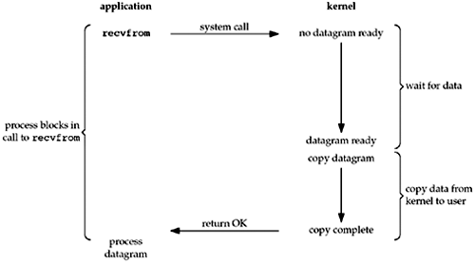
Blocking I/O Model
Simplified
By default, all sockets are blocking
read

Slide 78
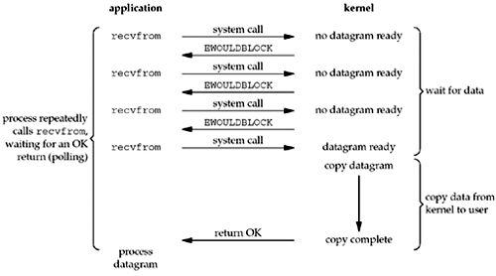
Nonblocking I/O Model
Simplified
Can set a socket to be nonblocking
telling the kernel "when an I/O operation that I request cannot be completed without putting the process to sleep, do not put the process to sleep, but return an error instead"
read
read
read
read

Slide 79
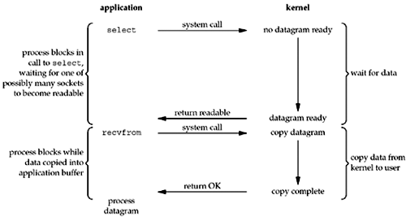
I/O Multiplexing Model
Simplified
Call select and block, instead of blocking in the actual I/O system call
When returned, one of the file descriptors is ready
read

Slide 80
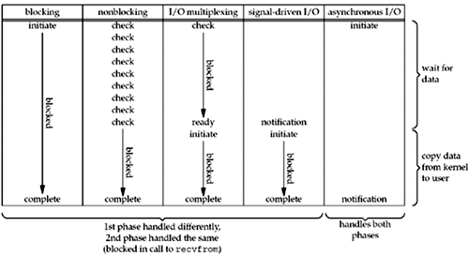
Comparison of the I/O Models
Simplified

Slide 81
select Function
TCP client establishes a connection with its server
int select(int maxfdp1, fd_set *readset, fd_set *writeset, fd_set *exceptset, const struct timeval *timeout);
E.g., call select and tell the kernel to return only when:
Any of the descriptors in the set {1, 4, 5} are ready for reading
Any of the descriptors in the set {2, 7} are ready for writing
Any of the descriptors in the set {1, 4} have an exception condition pending
10.2 seconds have elapsed

Slide 82
select Function
Tells the kernel which descriptors to test (reading, writing, or an exception condition) and how long to wait
not restricted to sockets; any file descriptor can be tested
struct timeval {
long tv_sec;//seconds
long tv_usec;//microseconds
};

Slide 83
select Function
Wait forever (timeval is a null pointer)
Return only when there is a ready descriptor
Wait up to a fixed amount of time
Test, but do not wait beyond the timeval
Do not wait at all (timeval is 0)
Return immediately after checking the descriptors

Slide 84
FD_* Functions
void FD_ZERO(fd_set *fdset);clear all bits in fdset
void FD_SET(int fd,fd_set *fdset);turn on the bit for fd in fdset
void FD_CLR(int fd,fd_set *fdset);turn off the bit for fd in fdset
int FD_ISSET(int fd,fd_set *fdset);is the bit for fd on in fdset?
fd_set rset;
FD_ZERO(&rset); initialize the set: all bits off
FD_SET(1, &rset); turn on bit for fd 1
FD_SET(4, &rset); turn on bit for fd 4
FD_SET(5, &rset); turn on bit for fd 5
select modifies the descriptor sets pointed to by these arguments

Slide 85
select Function
select modifies the descriptor sets pointed to by these arguments
The return value indicates the total number of bits that are ready across all the descriptor sets
The maxfdp1 argument specifies the number of descriptors to be tested
Its value is the maximum descriptor to be tested plus one

Slide 86
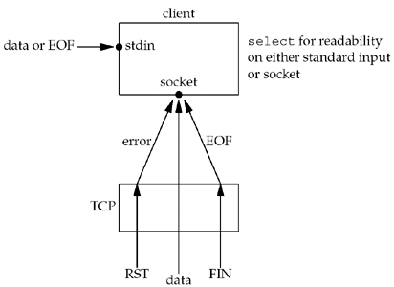
str_cli Function (Revisited)
Peer TCP sends data, the socket becomes readable and read returns greater than 0
number of bytes of data
Peer TCP sends a FIN (the peer process terminates), the socket becomes readable and read returns 0 (EOF)
Peer TCP sends an RST (the peer host has crashed and rebooted), the socket becomes readable, read returns -1, and errno contains the specific error code

Slide 87
str_cli Function (Revisited)
void str_cli(FILE *fp, int sockfd){
int maxfdp1; fd_set rset; char sendline[MAXLINE], recvline[MAXLINE];
FD_ZERO(&rset);
for ( ; ; ) {
FD_SET(fileno(fp), &rset); FD_SET(sockfd, &rset);
maxfdp1 = max(fileno(fp), sockfd) + 1;
Select(maxfdp1, &rset, NULL, NULL, NULL);
if (FD_ISSET(sockfd, &rset)) {//socket is readable
if (Readline(sockfd, recvline, MAXLINE) == 0) err_quit("str_cli: server terminated prematurely");
Fputs(recvline, stdout);
}
if (FD_ISSET(fileno(fp), &rset)) {//input is readable
if (Fgets(sendline, MAXLINE, fp) == NULL) return;//all done
Writen(sockfd, sendline, strlen(sendline));
}}}

Slide 88
str_cli Function (Revisited)
Notice that the same four I/O functions are used (fgets, writen, readline, and fputs)
but the order of flow within the function has changed
Instead of the function flow being driven by the call to fgets, it is now driven by the call to select
We have added greatly to the robustness of our client
with only a few additional lines of code

Slide 89
Batch Input and Buffering
Self-study
The original version operates in a stop-and-wait mode, which is fine for interactive use:
It sends a line to the server and then waits for the reply
This amount of time is one RTT plus the server's processing time
which is close to 0 for a simple echo server
How can we estimate the time it takes for a given number of lines to be echoed if we know the RTT between the client and server?

Slide 90
Batch Input and Buffering
Self-study
The original version operates in a stop-and-wait mode, which is fine for interactive use:
It sends a line to the server and then waits for the reply
This amount of time is one RTT plus the server's processing time
which is close to 0 for a simple echo server
How can we estimate the time it takes for a given number of lines to be echoed if we know the RTT between the client and server?
Hint: use ping and take average RTT over 30 measurements is 175 ms. for 84 bytes IP datagrams

Slide 91
Batch Input and Buffering
Self-study
Take the first 2,000 lines of a file of 98,349 bytes, for an average of 49 bytes per line
Add the sizes of the IP header (20 bytes) and the TCP header (20), the average TCP segment will be about 89 bytes, nearly the same as the ping packet sizes
Estimate that the total clock time to be around 350 seconds for 2,000 lines
because 2,000 x 0.175sec
actual measured time is about 354 seconds

Slide 92
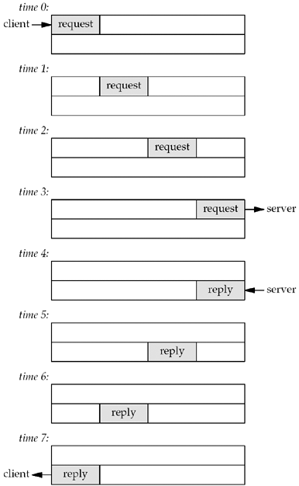
Batch Input and Buffering
Self-study
Since there is a delay between sending a packet and that packet arriving at the other end of the pipe, and since the pipe is full-duplex, the iterative server uses only a small fraction of the pipe's capacity

Slide 93
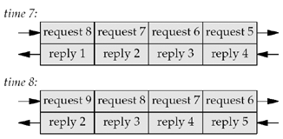
Batch Input and Buffering
Self-study
Can run our client in a batch mode
Redirect the input and output,
However, the output file is always smaller than the input file
should be identical for echo protocols

Slide 94
Batch Input and Buffering
Self-study
Assume that the input file contains only nine lines
The last line is sent at time 8
Cannot close the connection after writing this request
there are still other requests and replies in the pipe
Problem cause is our handling of an EOF on input:
str_cli returns to the main function, which then terminates
But in a batch mode, an EOF on input does not imply that we have finished reading from the socket;
might still be requests on the way to the server, or replies on the way back from the server

Slide 95
Batch Input and Buffering
Self-study
Solution:
send a FIN to the server, telling it we have finished sending data, but leave the socket descriptor open for reading

Slide 96
shutdown Function
Self-study
close decrements the descriptor's reference count and closes the socket only if the count reaches 0
shutdown can initiate TCP's normal connection termination sequence regardless of the reference count
close terminates both directions of data transfer, reading and writing
since a TCP connection is full-duplex, there are times when we want to tell the other end that we have finished sending, even though that end might have more data to send us

Slide 97
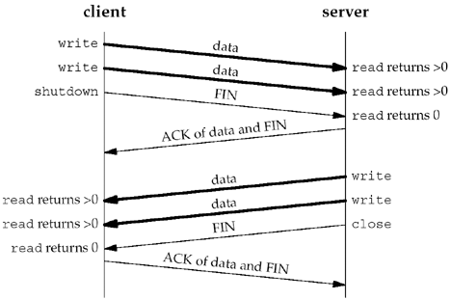
shutdown Function
Self-study
int shutdown(int sockfd, int howto);
SHUT_RD read half of the connection is closed
SHUT_WR write half of the connection is closed
SHUT_RDWR read half and the write half of the connection are both closed

Slide 98
str_cli (Revisited Again)
Self-study
void str_cli(FILE *fp, int sockfd){
int maxfdp1, stdineof; fd_set rset; char buf[MAXLINE]; int n;
stdineof = 0; FD_ZERO(&rset);
for ( ; ; ) {
if (stdineof == 0) FD_SET(fileno(fp), &rset);
FD_SET(sockfd, &rset);
maxfdp1 = max(fileno(fp), sockfd) + 1;
Select(maxfdp1, &rset, NULL, NULL, NULL);
if (FD_ISSET(sockfd, &rset)) {//socket is readable
if ( (n = Read(sockfd, buf, MAXLINE)) == 0)
if (stdineof == 1) return;//normal termination
else err_quit("str_cli: server terminated prematurely");
Write(fileno(stdout), buf, n);
}

Slide 99
str_cli (Revisited Again)
Self-study
if (FD_ISSET(fileno(fp), &rset)) {//input is readable
if ( (n = Read(fileno(fp), buf, MAXLINE)) == 0) {
stdineof = 1;
Shutdown(sockfd, SHUT_WR);//send FIN
FD_CLR(fileno(fp), &rset);
continue;
}
Writen(sockfd, buf, n);
}
}
}

Slide 100
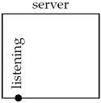
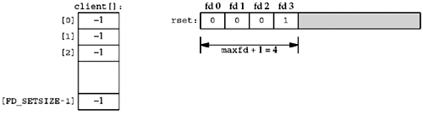
TCP Echo Server (Revisited)
Self-study
Has a listening descriptor
maintains 1 read set
starts in the foreground, so descriptors 0, 1, and 2 are set to input, output, and error
first available descriptor for the listening socket is 3
integer array contains the connected socket
initialized to -1 expect the listening sockets
1st argument to select will be 4
TCP server before first client has established a connection
Data structures for TCP server with just a listening socket

Slide 101
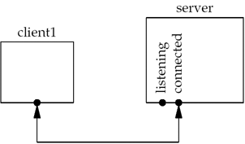
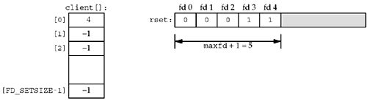
TCP Echo Server (Revisited)
Self-study
1st client establishes a connection with the server
the listening descriptor becomes readable and the server calls accept
new connected descriptor returned by accept will be 4
The server must remember the new connected socket in its client array, and the connected socket must be added to the descriptor set
TCP server after first client establishes connection
Data structures after first client connection is established

Slide 102
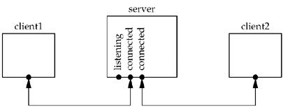
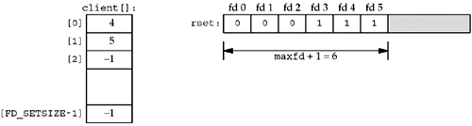
TCP Echo Server (Revisited)
Self-study
Sometime later a 2nd client establishes a connection
The new connected socket (which we assume is 5) must be remembered
TCP server after second client connection is established
Data structures after second client connection is established

Slide 103
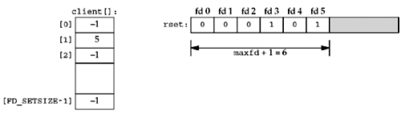
TCP Echo Server (Revisited)
Self-study
1st client terminates its connection
Client sends a FIN; makes descriptor 4 is readable
server reads this connected socket, read returns 0
close this socket and update our data structures
client[0] is set to -1 and descriptor 4 in the set is set to 0
TCP server after second client connection is established
Data structures after first client terminates its connection

Slide 104
TCP Echo Server (Revisited)
Self-study
As clients arrive, we record their connected socket descriptor in the 1st available entry in the client array
the first entry with a value of -1
also add the connected socket to the read descriptor set
maxi is the highest index in the client array that is currently in use and the variable maxfd (+1) is the current value of the first argument to select
number of connected clients is bounded by the min. of FD_SETSIZE = 1024 and the max. number of descriptors allowed

Slide 105
TCP Echo Server (Revisited)
Self-study
int main(int argc, char **argv){
int i, maxi, maxfd, listenfd, connfd, sockfd;
int nready, client[FD_SETSIZE];
ssize_t n;
fd_set rset, allset;
char buf[MAXLINE];
socklen_t clilen;
struct sockaddr_in cliaddr, servaddr;

Slide 106
TCP Echo Server (Revisited)
Self-study
listenfd = Socket(AF_INET, SOCK_STREAM, 0);
bzero(&servaddr, sizeof(servaddr));
servaddr.sin_family = AF_INET;
servaddr.sin_addr.s_addr = htonl(INADDR_ANY);
servaddr.sin_port = htons(SERV_PORT);
Bind(listenfd, (SA *) &servaddr, sizeof(servaddr));
Listen(listenfd, LISTENQ);
maxfd = listenfd; //initialize
maxi = -1; //index into client[] array
for (i = 0; i < FD_SETSIZE; i++) client[i] = -1;//-1 indicates available entry
FD_ZERO(&allset);
FD_SET(listenfd, &allset);

Slide 107
TCP Echo Server (Revisited)
Self-study
for ( ; ; ) {
rset = allset; // structure assignment
nready = Select(maxfd + 1, &rset, NULL, NULL, NULL);
if (FD_ISSET(listenfd, &rset)) { // new client connection
clilen = sizeof(cliaddr);
connfd = Accept(listenfd, (SA *) &cliaddr, &clilen);
for (i = 0; i < FD_SETSIZE; i++)
if (client[i] < 0) {
client[i] = connfd; /* save descriptor */
break;
}

Slide 108
TCP Echo Server (Revisited)
Self-study
if (i == FD_SETSIZE) err_quit("too many clients");
FD_SET(connfd, &allset);//add new descriptor to set
if (connfd > maxfd) maxfd = connfd;// for select
if (i > maxi) maxi = i;// max index in client[] array
if (--nready <= 0) continue;//no more readable descriptors
}
for (i = 0; i <= maxi; i++) {//check all clients for data
if ( (sockfd = client[i]) < 0) continue;
if (FD_ISSET(sockfd, &rset)) {
if ( (n = Read(sockfd, buf, MAXLINE)) == 0) { //client closed
Close(sockfd); FD_CLR(sockfd, &allset); client[i] = -1;
} else Writen(sockfd, buf, n);
if (--nready <= 0) break;//no more readable descriptors
}}}}

Slide 109
Summary of Part IV
The default is blocking I/O, which is also the most commonly used
The most commonly used function for I/O multiplexing is select
We tell the select function what descriptors we are interested in (for reading, writing, and exceptions), the maximum amount of time to wait, and the maximum descriptor number (+1)

Slide 110
Summary of Part IV
We used our echo client in a batch mode using select and discovered that even though the end of the user input is encountered, data can still be in the pipe to or from the server
To handle this scenario requires the shutdown function, and it lets us take advantage of TCP's half-close feature
The dangers of mixing stdio buffering (as well as our own readline buffering) with select caused us to produce versions of the echo client and server that operated on buffers instead of lines

